Slide 1
Mid-Project Presentation
Building a Comprehensive News Analysis, Recommendation, and Search Platform
Aryan Singh
Mihir Kumar Singh

Slide 2
Introduction
In an era of vast digital media content, the New York Times dataset stands as a treasure trove of information encompassing diverse topics, opinions, and sentiments. The project aims to harness this dataset’s potential by addressing three key challenges, each contributing to a holistic news consumption experience.

Slide 3
Project Objectives
Search Engine for News Articles
Sentiment Analysis of the News Articles
Content-Based Recommendation System
Comprehensive News Analysis

Slide 4
Data Source
The dataset, titled "The New York Times Articles," includes over 2.1 million articles, spanning from January 1, 2000, to the present day.
We scraped this data using the New York Times API (pynytimes).
It is important to note that this dataset is updated daily, ensuring that the latest articles from The New York Times are included.

Slide 5
Data Exploration
The dataset includes key features:
Abstract: A brief summary of the article's content.
Web URL: The article's web address.
Headline: The title or heading of the article.
Keywords: Tags associated with the article, providing insights into its content.
Pub Date: The publication date of the article.
Section Name: The section or category of the article.
Byline: The author or authors of the article.
Word Count: The number of words in the article.

Slide 6
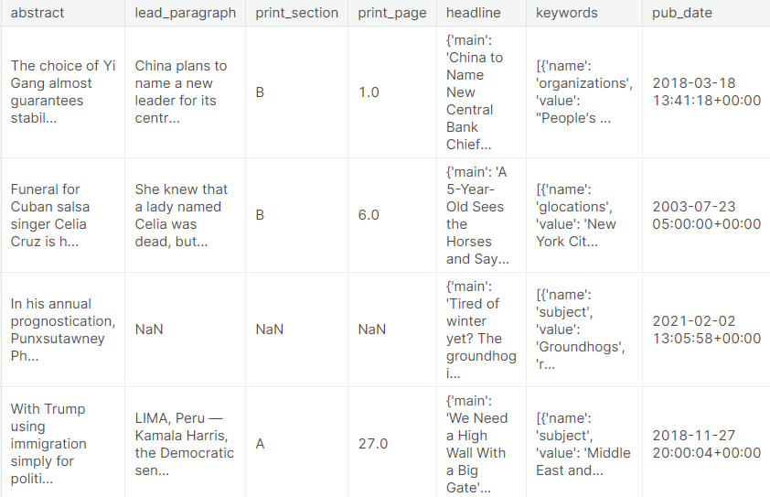
Data Preprocessing

Slide 7
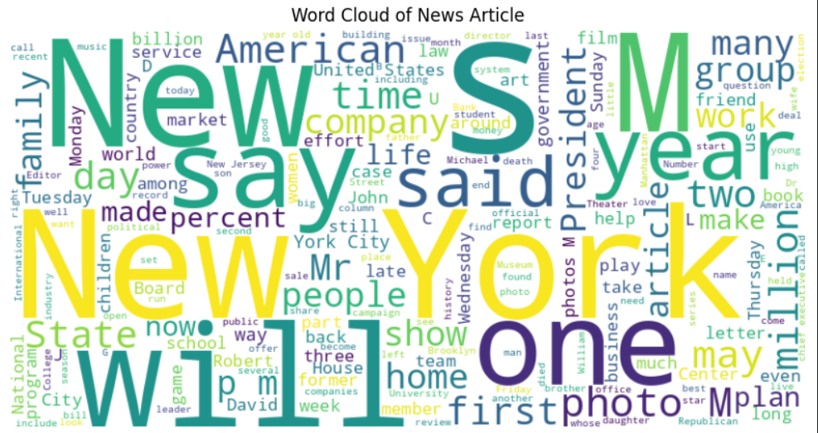
Word Cloud of News Article

Slide 8
Semantic Search based Search Engine
For implementing the semantic search in the the dataset we had 2 options. Either to use a word-embedding model or a pre-trained NLP transformer (BERT or Hugging Face).
Embeddings
For this project we were using Word2Vec embeddings. Our approach was :
Tokenization: Converting the sentences and words into tokens uniformly.
Training: Training the Word2Vec model on the preprocessed text data (tokens) . Then creation of a vector of similarity.
User Query: When the user submits a query to the model, it is again tokenized and converted to a vector by the model.
Ranking: A ranking is calculated on the similarity score (Cosine Similarity Score). And the top 5 articles were represented to the user with the similarity score.
However the accuracy was not very good and the training required high computing power due to the large dataset size.

Slide 9
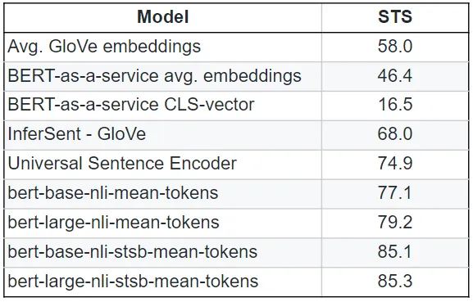
Performance of Pre-Trained Models
Thus we shifted to pre-trained NLP Transformers. These transformers have contextual embeddings capturing the meaning of words based on the surrounding words in a sentence. They were easily available and fine tuning was easier. For this project we’ll be using bert-base-nli-mean-tokens.

Slide 10
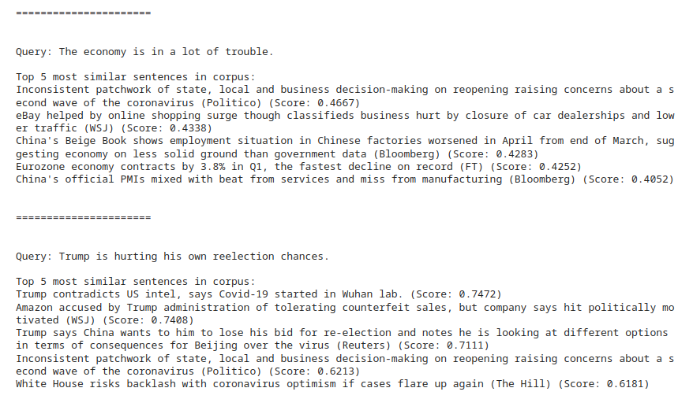
Results of Semantic Search

Slide 11
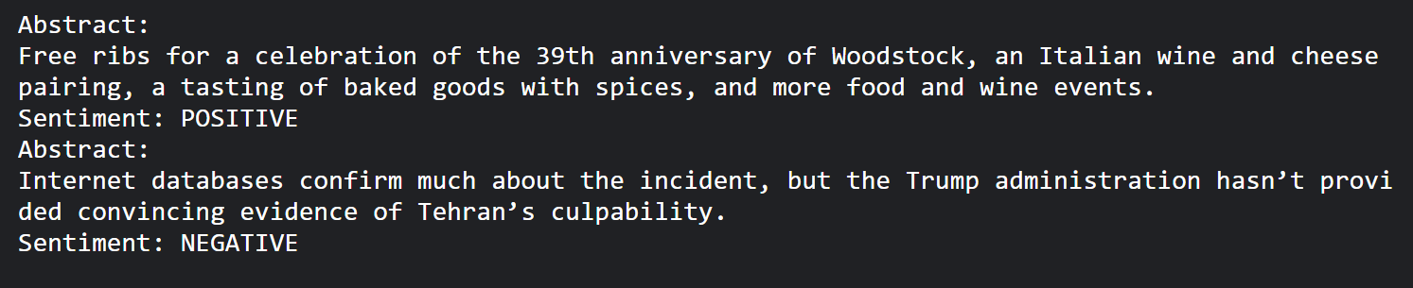
Sentiment Analysis
We used the DistilBERT model from Hugging Face and PySpark for efficient data processing to analyze the sentiment in news articles.

Slide 12
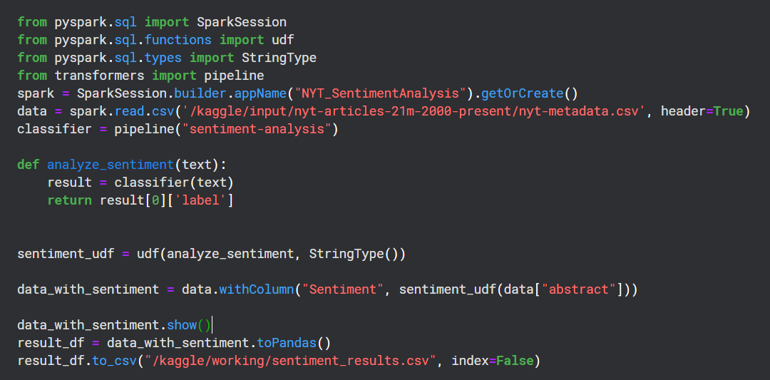
Sentiment Analysis with Pyspark

Slide 13
Thank You
Name - Aryan Singh
Email - aryan.s@iitg.ac.in
Roll No. - 210150008
Branch - DSAI
Name - Mihir Kumar Singh
Email - mihir.singh@iitg.ac.in
Roll No. - 200121030
Branch - Engineering Physics

